Slide 1
01.28.20
Type Casting
If statement scope
Arrays
assignment02 - Shared Birthdays
No tests for this assignment

Slide 2
Type Casting
Check out this tutorial on w3 schools
int x = 4;
int y = 3;
y / x; // results in 0. an int and an int result in an int
(double)y / x ; // results in .75.
// We type cast the int y to a double by putting
// the type in parenthesis right before it
Notes:
Print out syllabus
Print out BJ syllabus, read from his

Slide 3
If Statement Scope
Any variable declared inside of a block of code (like an if statement) can only be seen inside of that block of code.
if (x > y ) {
int r = 27; // r is declared in the if statement
} // the if statement ends here
x = r + 1; // r cannot be seen here
This will result in an error.
Notes:
Print out syllabus
Print out BJ syllabus, read from his

Slide 4
If Statement Scope
Instead, try declaring the variable outside of the block of code, then just updating its value inside of the code block.
int r = 0; // r is declared before the if statement
if (x > y ) { // the if statement starts
r = 27; // r is declared in the if statement
} // the if statement ends here
x = r + 1; // r CAN be seen here
NO ERROR!
Notes:
Print out syllabus
Print out BJ syllabus, read from his

Slide 5
Return
Review return in estimate method.
Don’t delete!
Notes:
Print out syllabus
Print out BJ syllabus, read from his

Slide 6
Testing
Try testing your code with different inputs
%java PiEstimator
%java PiEstimator 10
%java PiEstimator 0
%java PiEstimator 99 5 2
%java PiEstimator hello
%java PiEstimator
Notes:
Print out syllabus
Print out BJ syllabus, read from his

Slide 7
Print out the result!!
When you invoke estimate() to run, don’t forget to
System.out.println(estimate(darts));
Notes:
Print out syllabus
Print out BJ syllabus, read from his

Slide 8
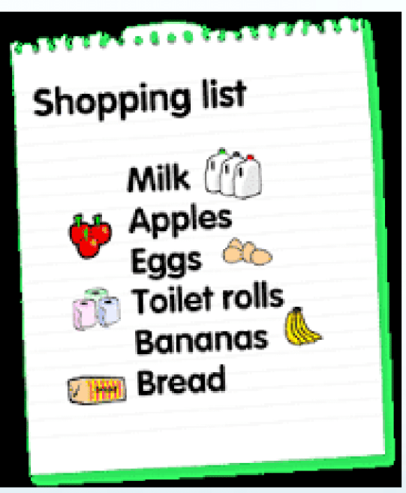
Arrays
Java uses arrays to remember elements of one type in an organized way
String[] shoppingList = {“milk”, “eggs”, “bread”};
Notes:
Print out syllabus
Print out BJ syllabus, read from his

Slide 9
Arrays
Create an array and save memory for each index
int intArray[]; //declaring array
intArray = new int[20]; // allocating memory to array
OR
int[] intArray = new int[20]; // combining both statements in one
Notes:
Print out syllabus
Print out BJ syllabus, read from his

Slide 10
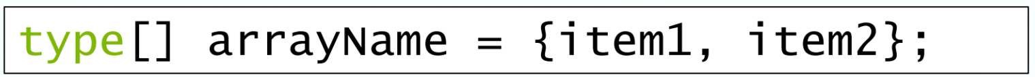
Arrays
Declare an array literal.
An array is a sequence of elements of one type.
Notes:
Print out syllabus
Print out BJ syllabus, read from his

Slide 11
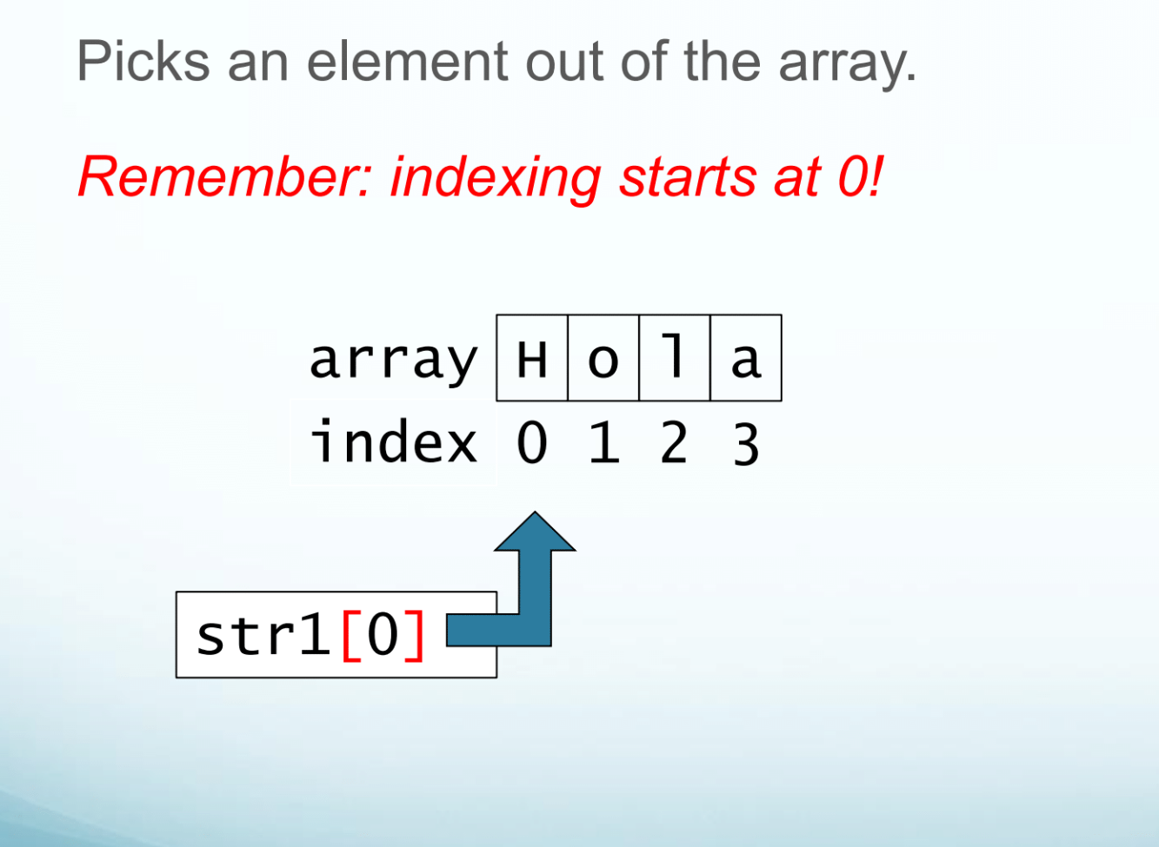
Arrays - Indexing
Notes:
Print out syllabus
Print out BJ syllabus, read from his

Slide 12
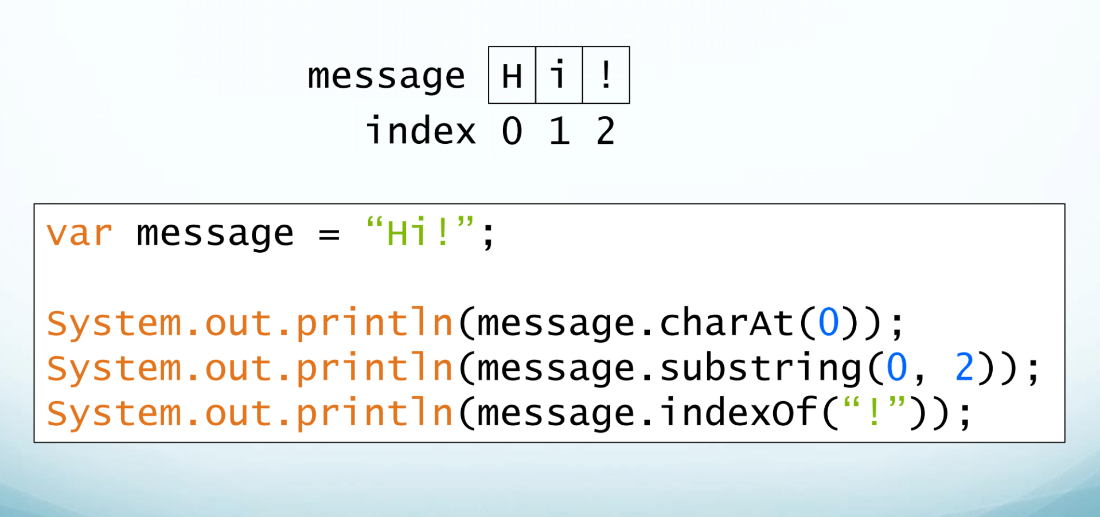
Strings are like Arrays
Notes:
Print out syllabus
Print out BJ syllabus, read from his

Slide 13
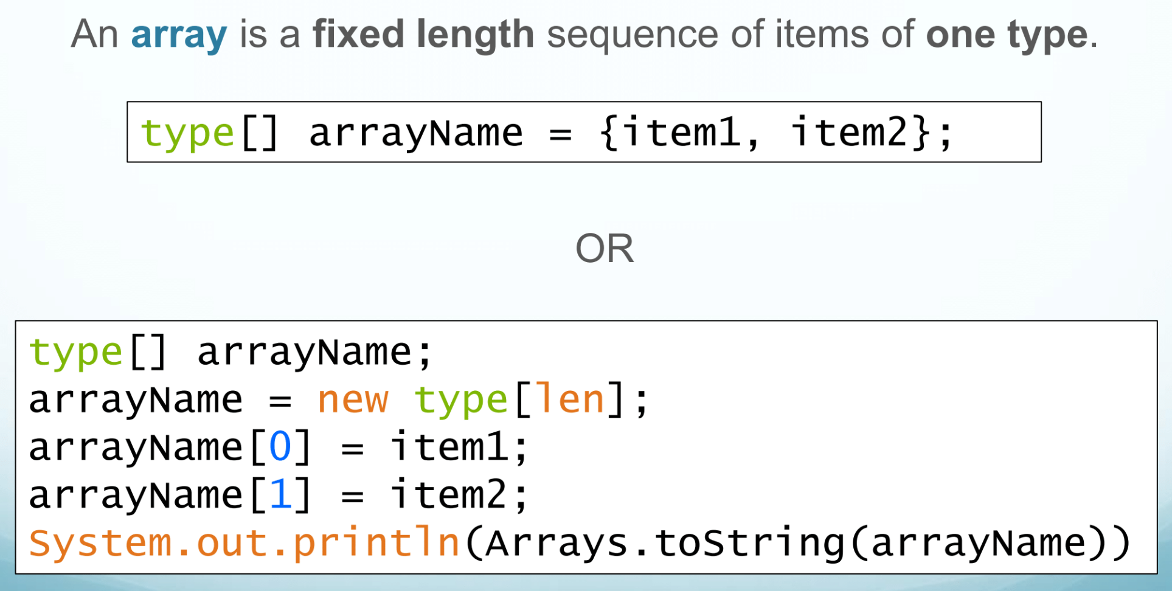
Create and populate an array
Notes:
Print out syllabus
Print out BJ syllabus, read from his

Slide 14
Array length
int[] cmsiArray = {185, 186};
System.out.println(cmsiArray.length);
Notes:
Print out syllabus
Print out BJ syllabus, read from his

Slide 15
Try it out
In JShell, create and initialize a new array of three integers. These can be any integers.
Initialize your array in both ways:
Using the {} shortcut
Add elements one at a time
Then print out each element in the array with a loop.
Next, add 1 to each element in the loop and print out the values again.
Notes:
Print out syllabus
Print out BJ syllabus, read from his

Slide 16
Shared Birthday
Out of 23 people, there is a 50% chance that at least 2 people share the same birthday!
Check it out on the pudding
Notes:
Print out syllabus
Print out BJ syllabus, read from his

Slide 17
Shared Birthday
Imagine there is a calendar with 3 days
0
1
2
Notes:
Print out syllabus
Print out BJ syllabus, read from his

Slide 18

Shared Birthday
And we have 2 people with birthdays on that calendar
Imagine there is a calendar with 3 days
0
1
2
Notes:
Print out syllabus
Print out BJ syllabus, read from his

Slide 19
Shared Birthday
Let’s randomly generate birthdays for those 2 people to see if they end up on the same day
0
1
2
Notes:
Print out syllabus
Print out BJ syllabus, read from his

Slide 20
Shared Birthday
Trial 1
0
1
2
Notes:
Print out syllabus
Print out BJ syllabus, read from his

Slide 21
Shared Birthday
Trial 1
0
1
2
Trial 2
0
1
2
Notes:
Print out syllabus
Print out BJ syllabus, read from his

Slide 22
Shared Birthday
Trial 1
0
1
2
Trial 2
0
1
2
Trial 3
0
1
2
Notes:
Print out syllabus
Print out BJ syllabus, read from his

Slide 23
Shared Birthday
So out of 3 trials, the probability that at least 2 people had the same birthday out of 2 total people is ⅓
33.3333%
Trial 1
0
1
2
Trial 2
0
1
2
Trial 3
0
1
2
Notes:
Print out syllabus
Print out BJ syllabus, read from his

Slide 24
How to simulate the shared birthday problem
Let’s look at the template.
Pull the newest version.
How to fill in probabilityEstimate()
Notes:
Print out syllabus
Print out BJ syllabus, read from his

Slide 25
How to simulate the shared birthday problem
create an array of integers of length days // each index represents a day in the calendar
for every trials {
for every index in your array {
set integer in each index to 0 // represents total num of bdays on that day. Should reset for each trial
}
for each people {
generate a random int between 0 and the total number of days minus 1 //Math.floor(Math.random() * (max - min + 1)) + min
// This int represents that persons birthday
add 1 to the index that correlates with the birthday
}
for each day in the calendar {
if the value at the index for that day has a value greater than 0 { //if there is more than one birthday on that day
add 1 to sharedBdayCount; // number of days with a shared bday
}
}
If sharedBdayCount is at least 1 {
Add 1 to daysOver1Bday // the trial has at least 1 shared birthday (it is a successful trial)
}
}
return daysOver1Bday / trials //number of successful trials over total trials
Notes:
Print out syllabus
Print out BJ syllabus, read from his

